Slide 1
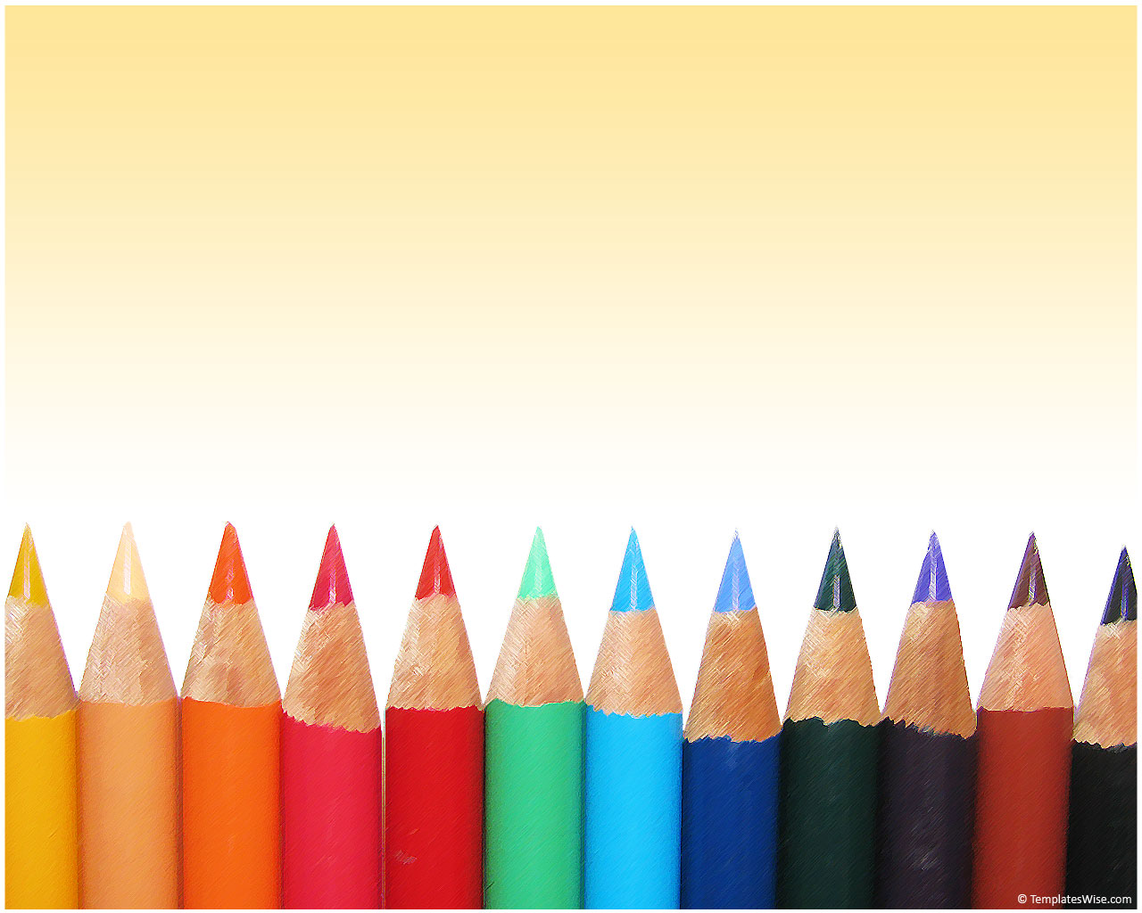
Plot Chart!
Ms.Bode

Slide 2
Plot
4
3 5
1 2 6

Slide 3
Plot
4
3 5
1 2 6
time
tension

Slide 4
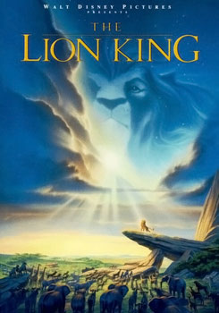
Example for Plot: The Lion King

Slide 5
1. Exposition
Usually the beginning of the story, this part introduces the setting, the characters, and their situation.

Slide 6
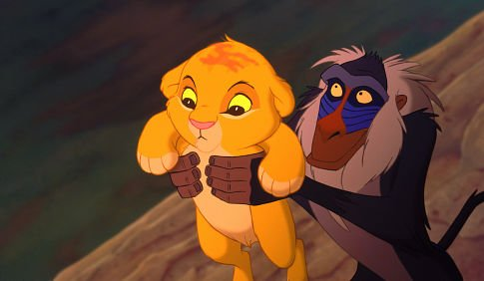
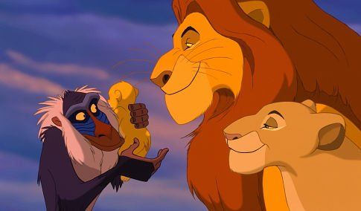
We meet Simba in Africa.
Movie clip

Slide 7
2. Conflict Introduced
When the conflict or problem is introduced and the action begins.

Slide 8
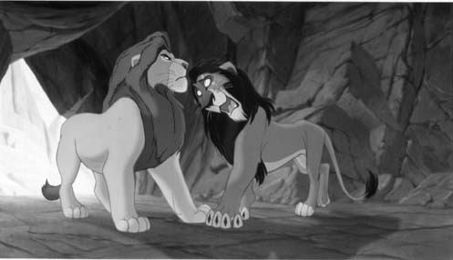
Scar wants to be king!

Slide 9
3. Rising Action
All the events that happen from the introduction of the conflict up to the climax.

Slide 10
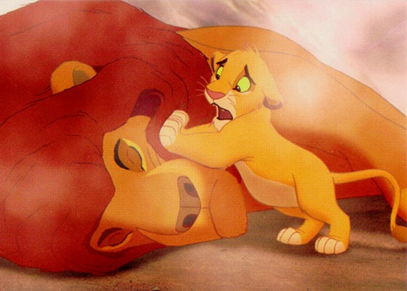
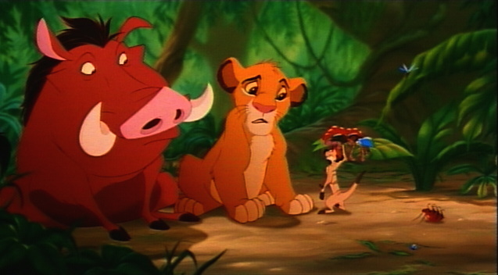
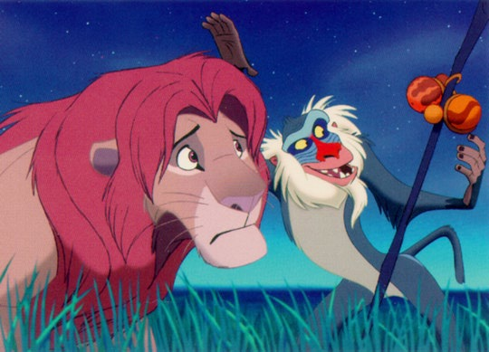
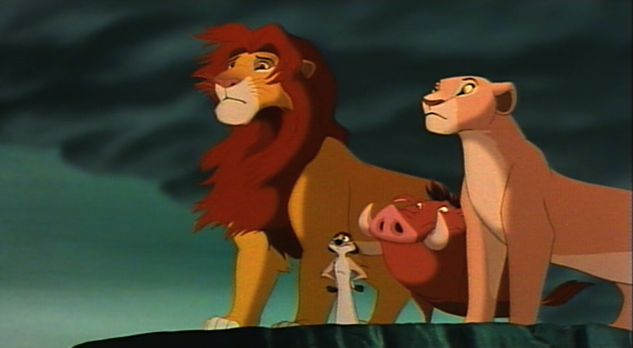
Mufasa is killed, then Simba runs away. We meet Pumba and Timon, and Simba grows up. Rafiki, Mufasa and Nala talk to Simba, so he returns to Pride Rock.

Slide 11
4. Climax
The point of greatest tension in the story; the moment when the opposing forces come into direct conflict.

Slide 12
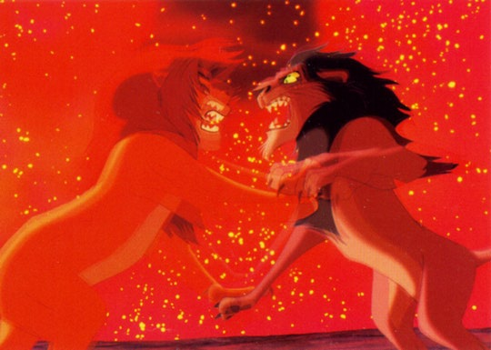
Scar and Simba fight!

Slide 13
5. Falling Action
All the events that happen from the climax to the resolution. Usually things begin to return to normal.

Slide 14
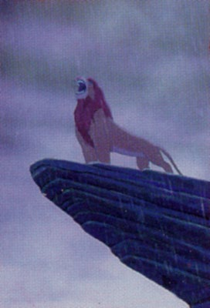
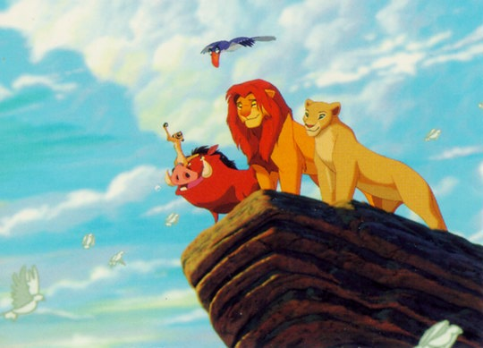
Simba takes back Pride Rock, the savannah regrows, and the animals return.

Slide 15
6. Resolution
When the story comes full circle; the conflict is resolved or the story is finalized.

Slide 16
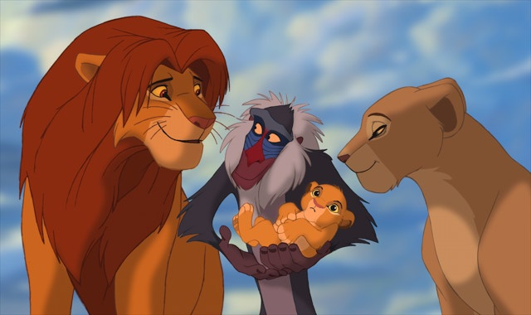
Simba has a baby; it’s the circle of life!

Slide 17
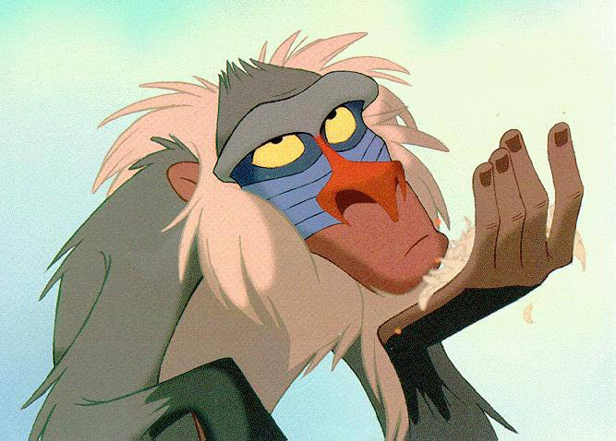
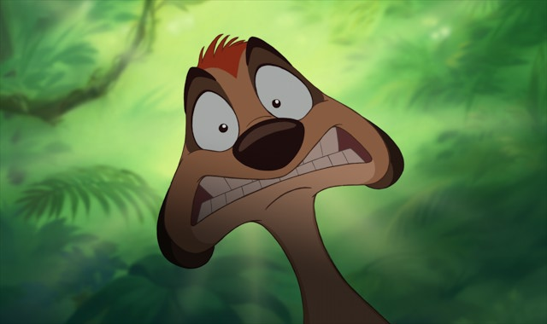
Thanks to:
Imdb.com for the trailer clip
Lionking.org for the pictures and screenshots

