Slide 1
Warm-Up 9/29
Give the meaning
Anthrop
Hypo
Mono
Osteo
Psych
Give the root
Heart
Half
Fire
Ship
Star

Slide 2
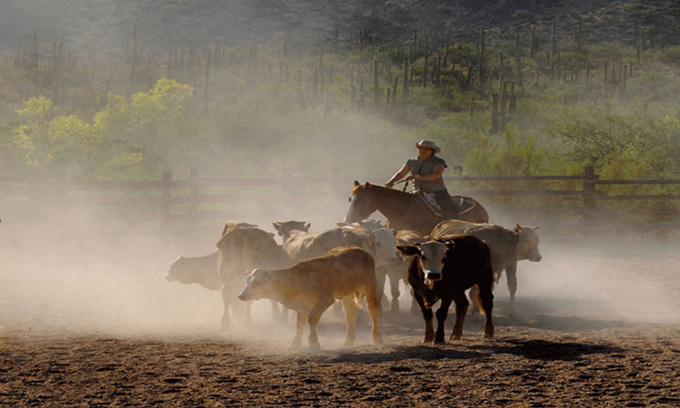
SAT Vocabulary – 2nd Six Weeks
Rustle (v.): to make a soft, muffled crackling sound; to round up an steal (cattle, horses, or sheep)

Slide 3
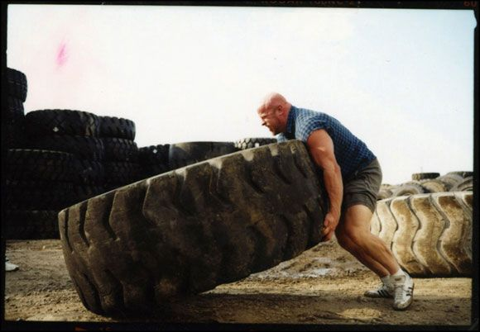
SAT Vocabulary – 2nd Six Weeks
Hoist (v.): to physically raise or lift something up

Slide 4
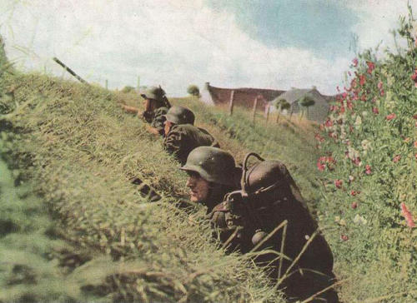
SAT Vocabulary – 2nd Six Weeks
Ambush (n. or v.): a surprise attack by people in a hidden position; to make a surprise attack

Slide 5
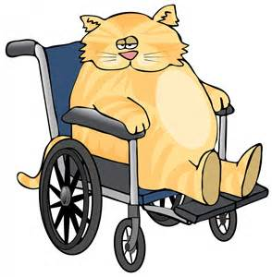
SAT Vocabulary – 2nd Six Weeks
Feign (v.): to pretend to be affected by (a feeling, a state, or an injury)

Slide 6
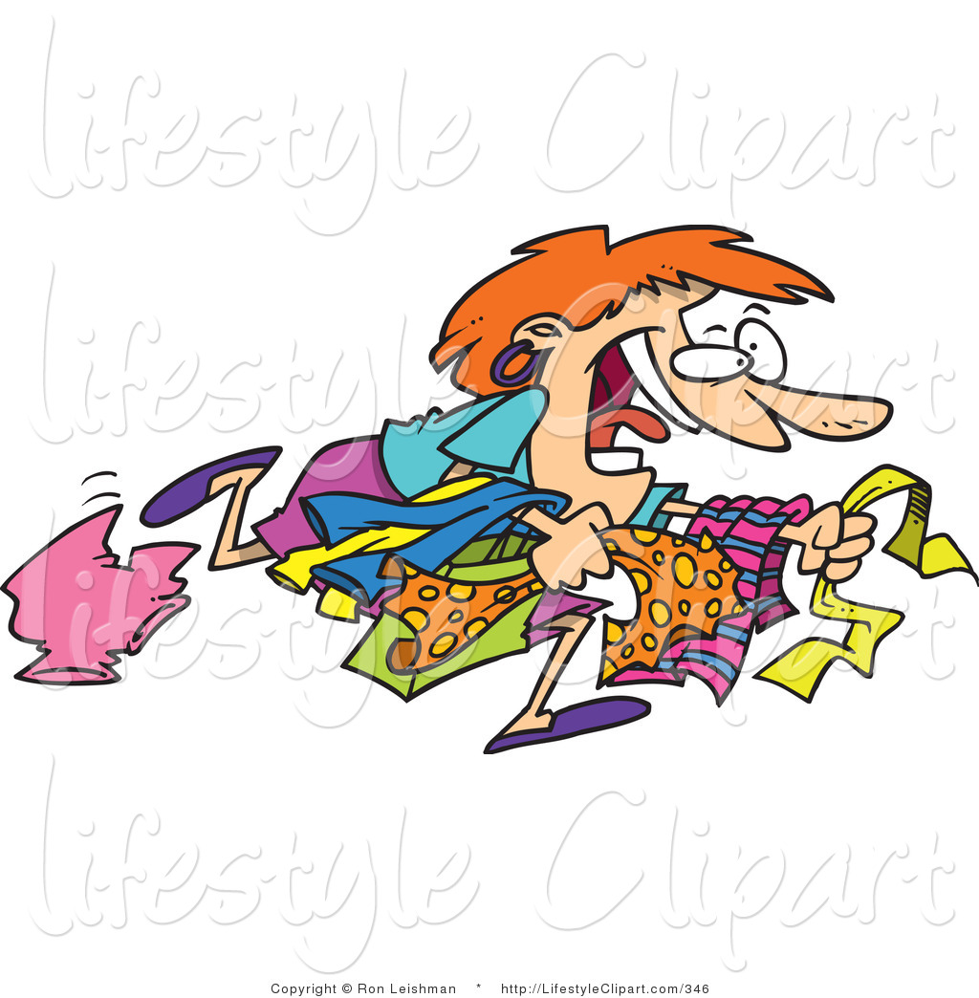
SAT Vocabulary – 2nd Six Weeks
Frenzied (adj.): wildly excited or uncontrolled

Slide 7
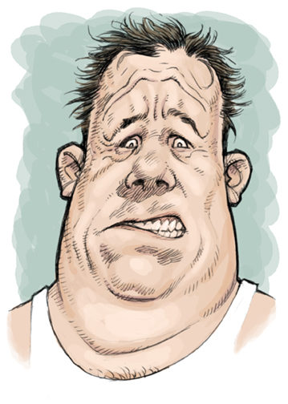
SAT Vocabulary – 2nd Six Weeks
Grimace (n. or v.): an ugly, twisted expression on a person’s face, usually expressing disgust, pain, or sarcastic amusement

Slide 8
SAT Vocabulary – 2nd Six Weeks
Defiance (n.): open resistance; bold disobedience

Slide 9
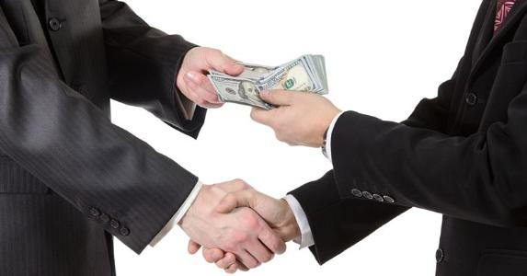
SAT Vocabulary – 2nd Six Weeks
Beholden (adj.): owing thanks or having a duty to someone in return for help or service

Slide 10
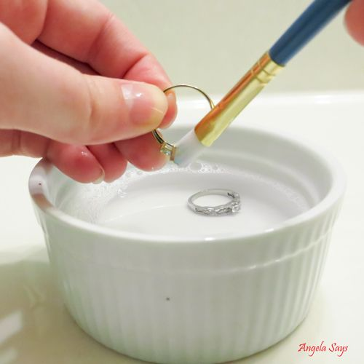
SAT Vocabulary – 2nd Six Weeks
Burnish (v.): to polish (especially metal) by rubbing; to enhance or perfect

Slide 11
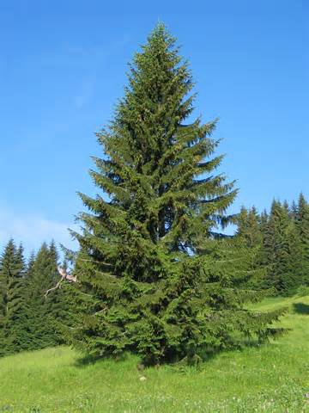
SAT Vocabulary – 2nd Six Weeks
Spruce (v.): to arrange neatly or tidy up; a widespread tree shaped like a cone

Slide 12
Warm-Up 6th
Defiance (n.): open resistance; bold disobedience
Beholden (adj.): owing thanks or having a duty to someone in return for help or service
Burnish (v.): to polish (especially metal) by rubbing; to enhance or perfect
Spruce (v.): to arrange neatly or tidy up; a widespread tree shaped like a cone

Slide 13
Warm-Up 2nd, 4th, 7th
Use each word in a sentence:
Beholden (adj.): owing thanks or having a duty to someone in return for help or service
Feign (v.): to pretend to be affected by (a feeling, a state, or an injury)
Ambush (n. or v.): a surprise attack by people in a hidden position; to make a surprise attack

