Slide 1
SAT Vocabulary – Unit 3
Exasperate (v.): irritate intensely; infuriate

Slide 2
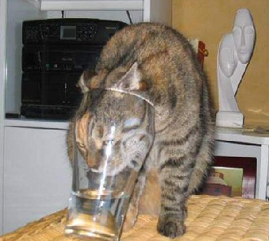
SAT Vocabulary – Unit 3
Futile (adj.): useless; pointless

Slide 3
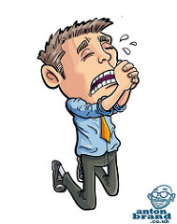
SAT Vocabulary – Unit 3
Implore (v.) to beg sincerely or desperately for

Slide 4
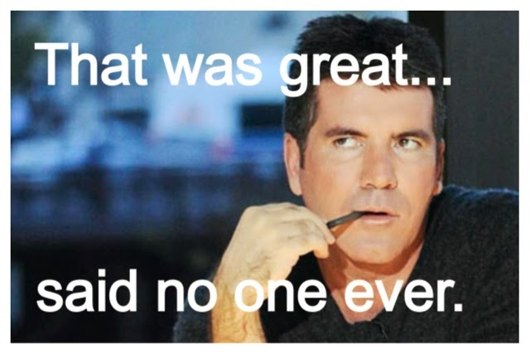
SAT Vocabulary – Unit 3
Facetious (adj.): treating serious issues with unnecessary humor; sarcastic

Slide 5
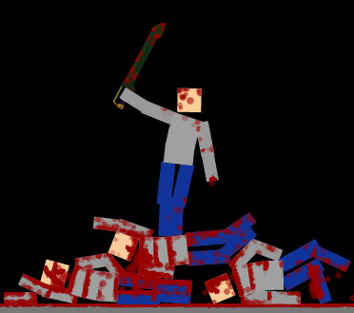
SAT Vocabulary – Unit 3
Mutilate (v.): to inflict a violent or serious injury on

Slide 6
SAT Vocabulary – Unit 3
Precarious (adj.): uncertain; dangerous

Slide 7
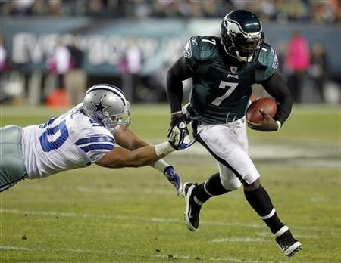
SAT Vocabulary – Unit 3
Evade (v.): to escape or avoid, especially by trickery

Slide 8
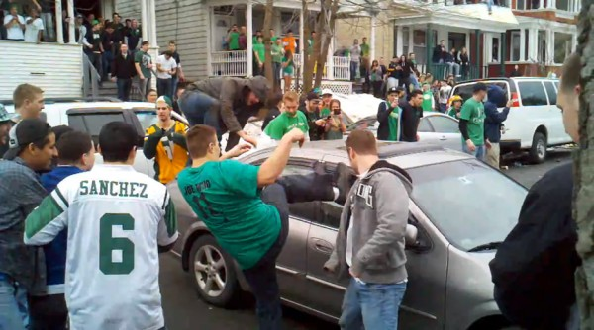
SAT Vocabulary – Unit 3
Deplorable (adj.): deserving strong condemnation; dishonorable; really bad…

Slide 9
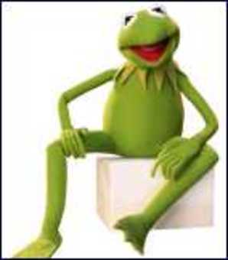
SAT Vocabulary – Unit 3
Amiable (adj.): having or displaying a friendly manner

Slide 10
SAT Vocabulary – Unit 3
Vindicate (v.): to clear of blame or suspicion; to show or prove to be right or reasonable

